Slide 1


Ajasňa veňvetevh
Born to Inspire
Company Profile
M/s. Ajasra Vervetech
(Hot Dip Galvanizing)
Plot no. 274-D/B, Second Phase, Harohalli Industrial Area, Kanakapura Tq., Ramanagara Dist.
Harohalli – 562 112
Mob- +91 82966 63245
Email- ajasravervetech@gmail.com Web- www.ajasravervetech.com
1
Ajasra Vervetech

Slide 2
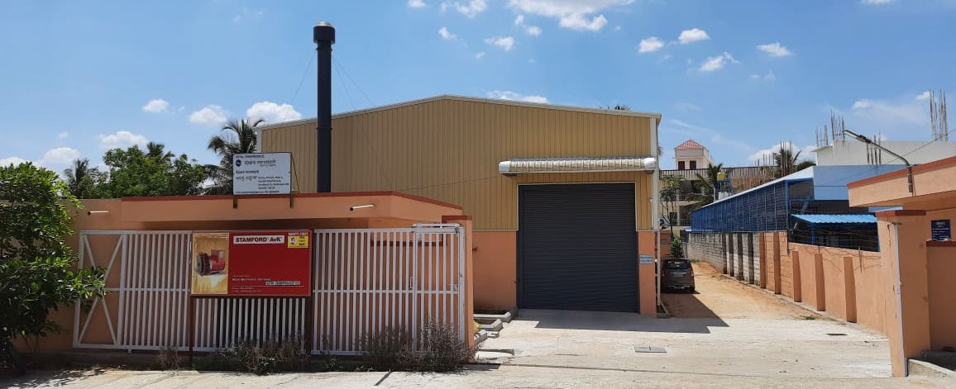
Introduction
M/s. AJASRA VERVETECH is a Partnership Company, promoted by Mrs. Kalpana Sreedar & Mr. K Sreedar.
Mr. K Sreedar, a mechanical engineer with over 32 years of Industrial experience. Specialized in handling green field projects, management systems, setting up of Hot dip galvanizing facilities.
Ajasra Vervetech developed Hot dip galvanizing facility to meet the growing demand of galvanizing requirement. We cater our services to energy (PGCIL, NTPCL, domestic power distribution agencies,), transportation (railways, metro, airports), constructional, communication(OFC) and general engineering sectors.
Ajasra Vervetech

Slide 3
Statutory Approvals
Firm registration Certificate
Permanent Account No. (PAN)
: RMG-F16-2020-21
: ABSFA8302N
3. Tax Deduction & Collection Account No. : BLRA35924A
(TAN)
Goods & Service registration (GSTN)
MSME Registration
Pollution Control Consent
Factory License
ISO QMS, ISO EMS, ZED
: 29ABSFA8302N1ZS
: UDYAM-KR-29-0000665
: AW- 324585
: MYB-25870.
: 9001:2015, 14001:2015 and ZED Bronze
Certified
Ajasra Vervetech

Slide 4
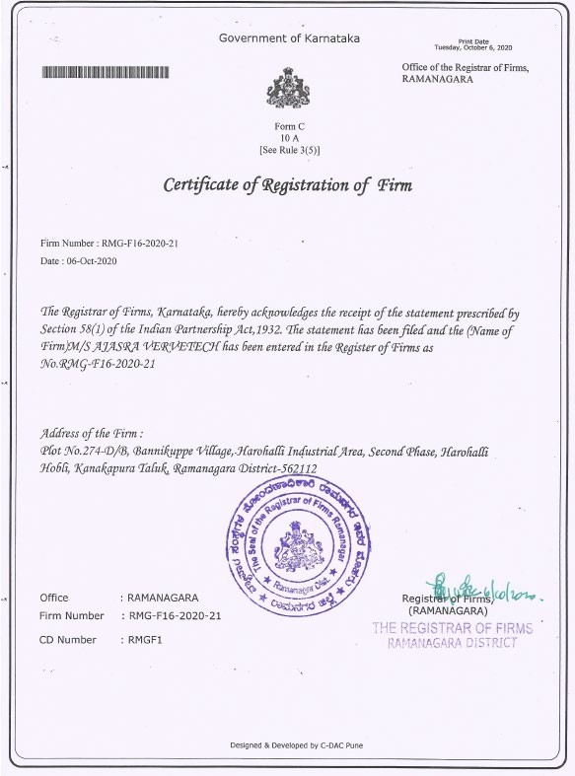
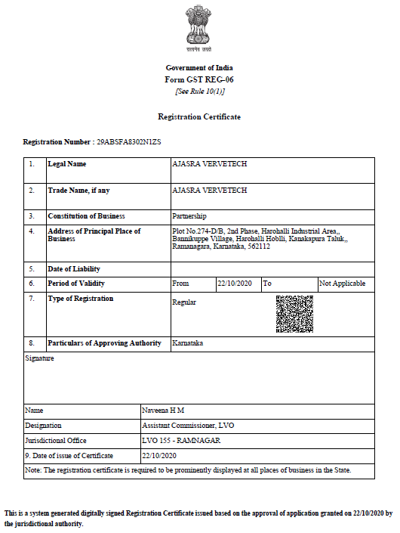


Statutory Approvals
Ajasra Vervetech

Slide 5
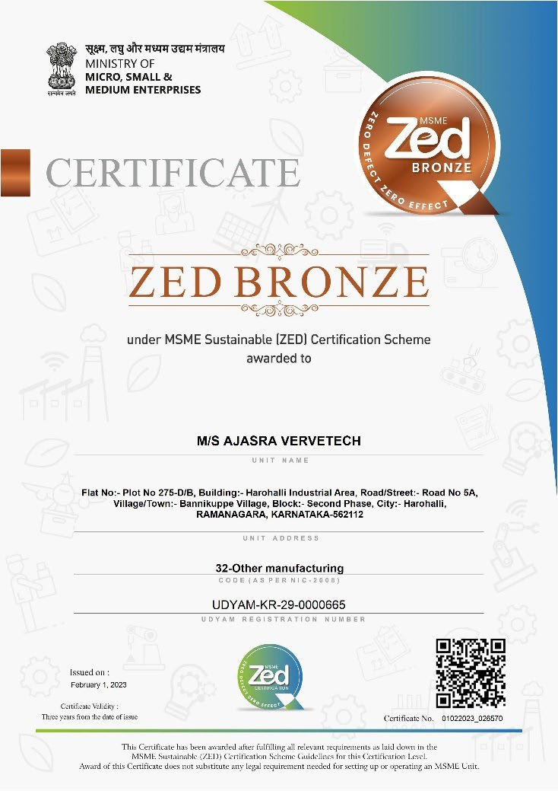
Certificates
5
Ajasra Vervetech
Ajasra Vervetech

Slide 6
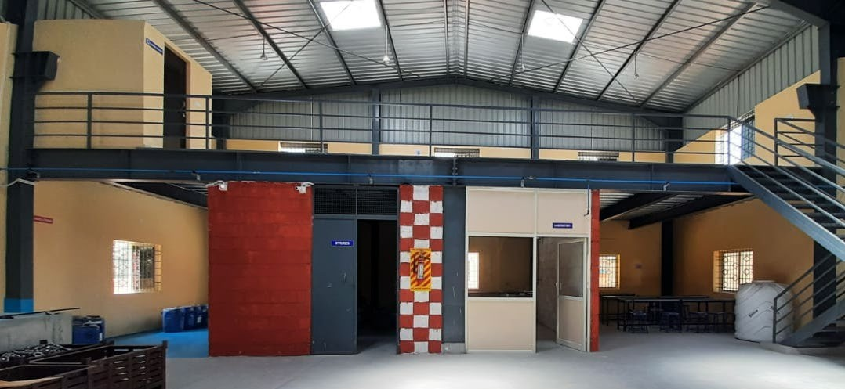
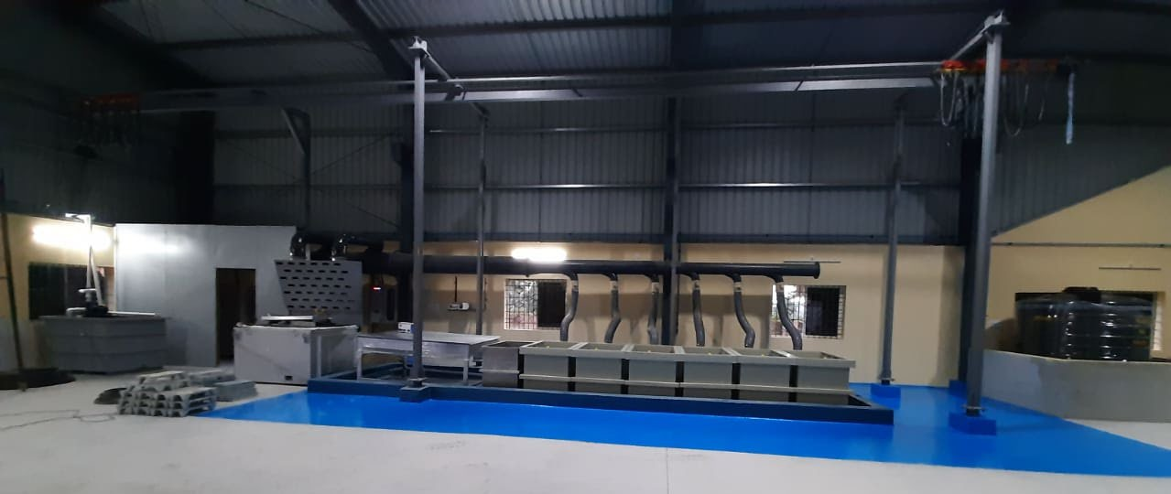
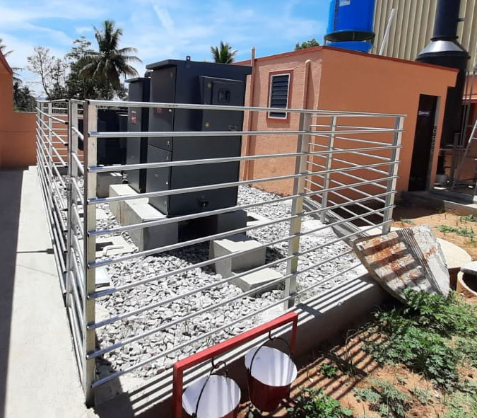
Infrastructure
100 KVA of electrical HT power.
5000 sft industrial shed with 1000 sft mezzanine floor.
2400 MT/annum hot dip galvanizing equipment with suitable utility equipment
(Wet scrubber, Air compressor, material handling equipment, weighing scale,
fully equipped laboratory).
Size of Zinc Bath – 1000 X 550 X 750 mm.
Dedicated storage for chemicals, Zinc, customer parts.
Ajasra Vervetech

Slide 7
Hot Dip Galvanizing Process Flow
Degreasing
Rinsing
Pickling
Pickling
Rinsing
Rinsing
Hot Fluxing
Drying
Zinc Bath
Spinning
Cooling
Passivation
Ajasra Vervetech

Slide 8
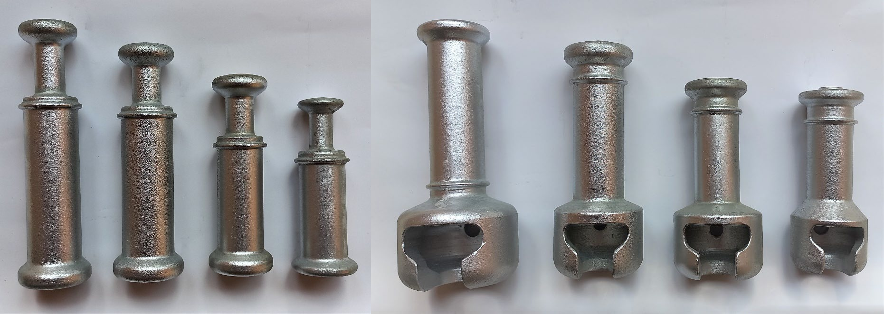
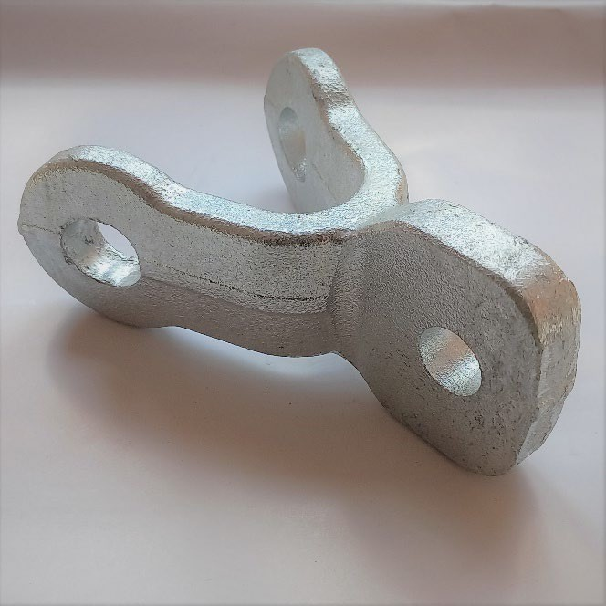
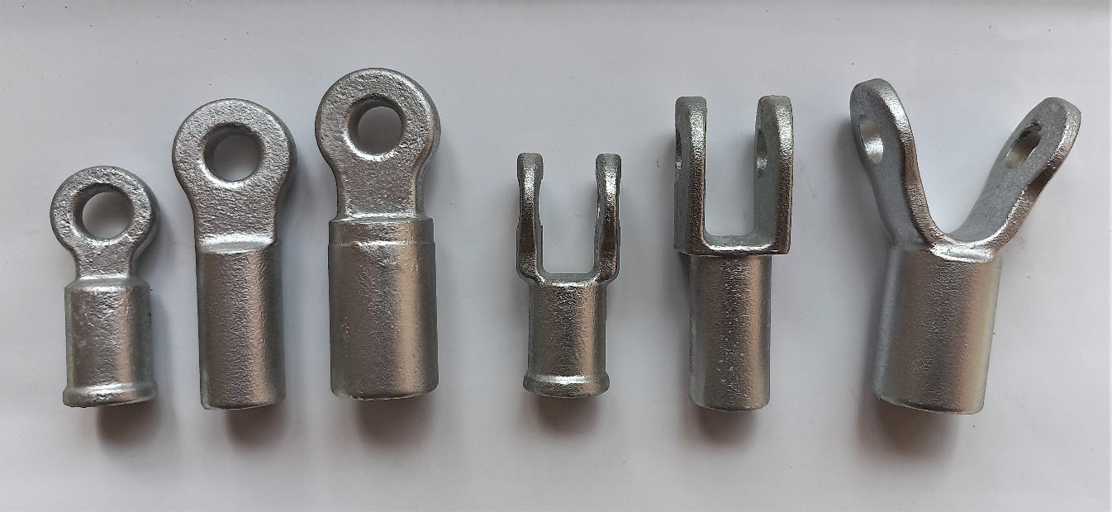
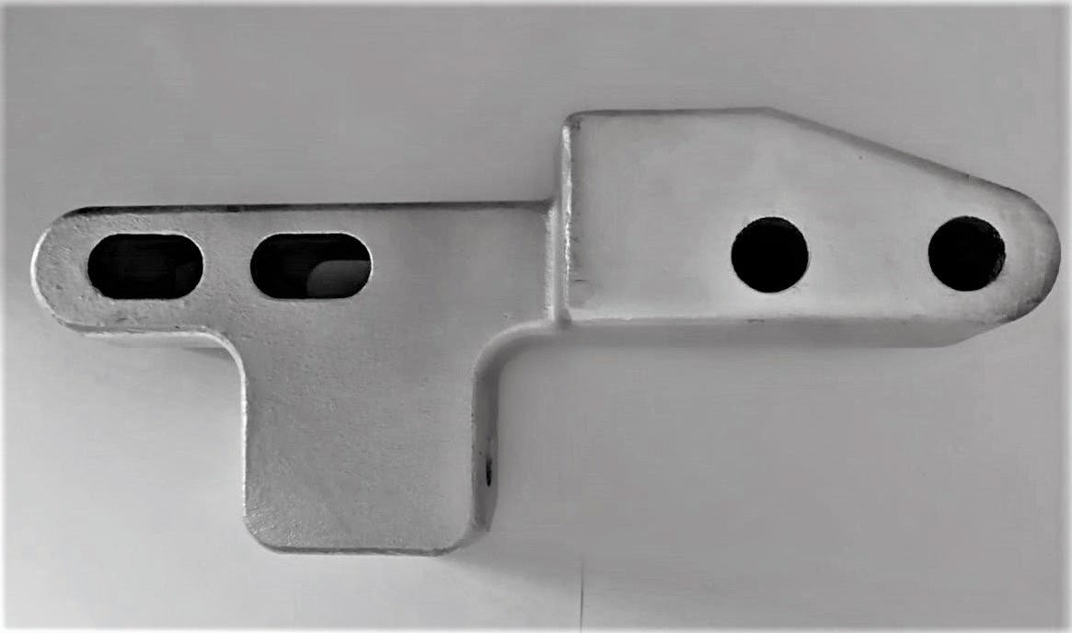
Energy Sector components
Ajasra Vervetech

Slide 9
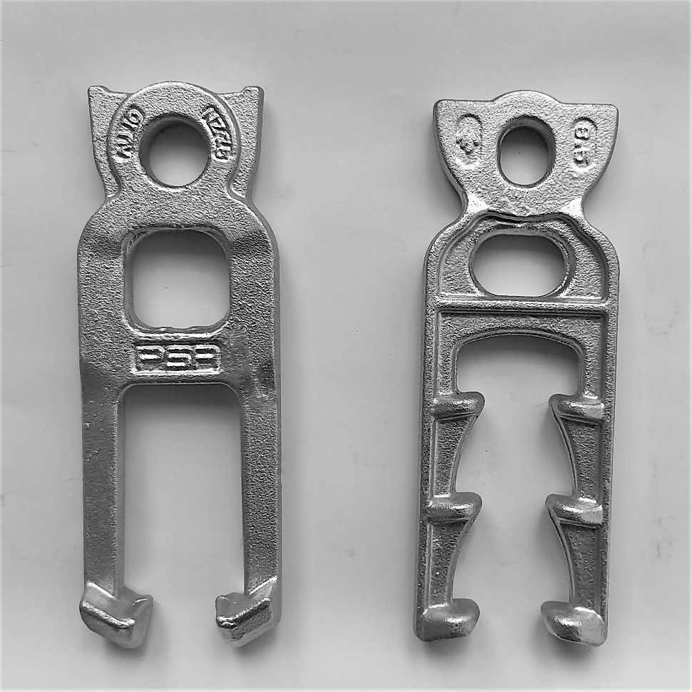
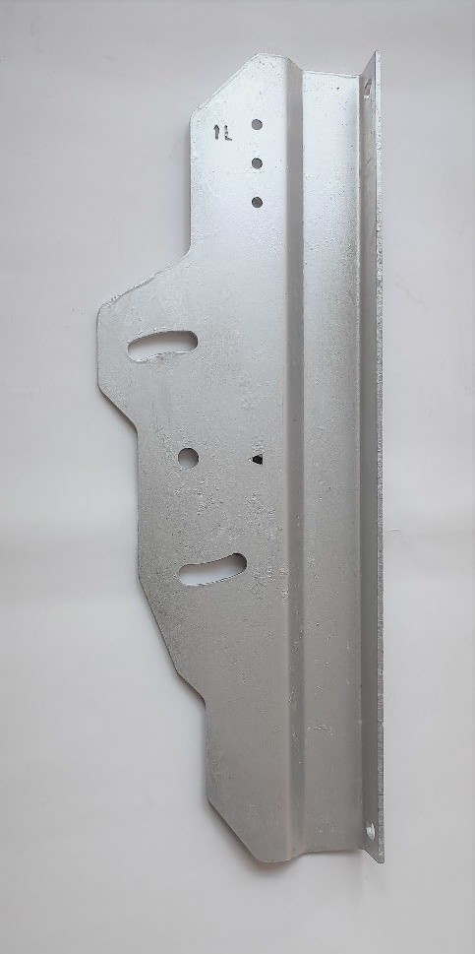
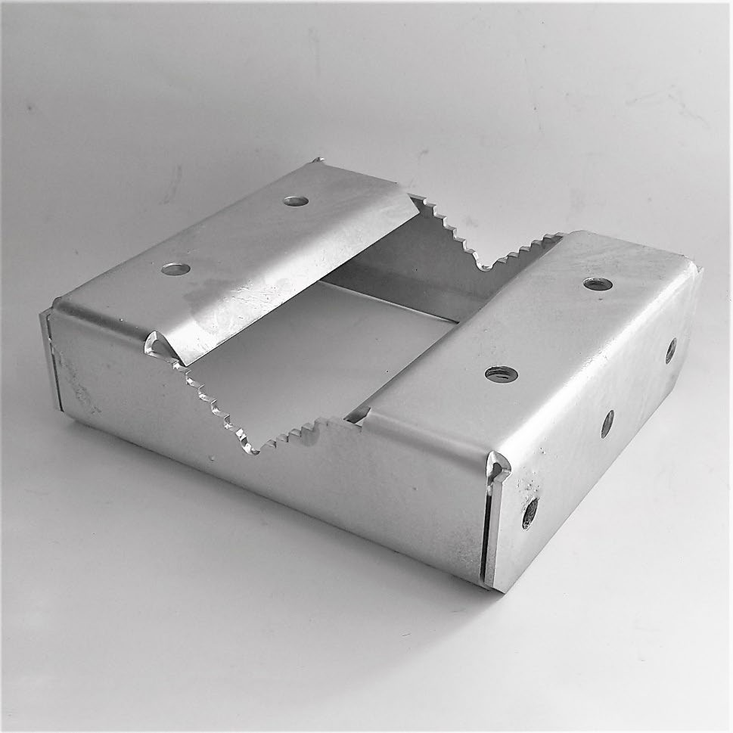
Construction components
9
Ajasra Vervetech
Ajasra Vervetech

Slide 10
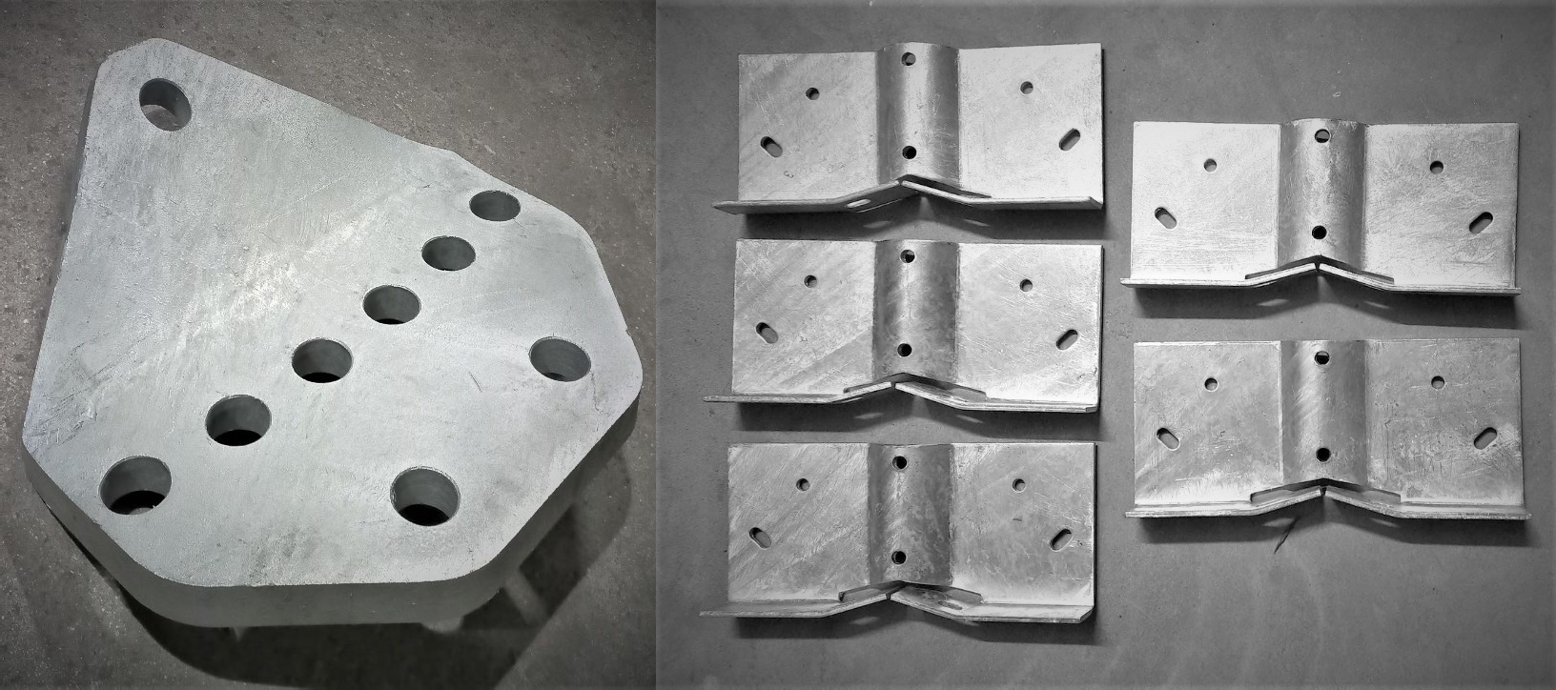
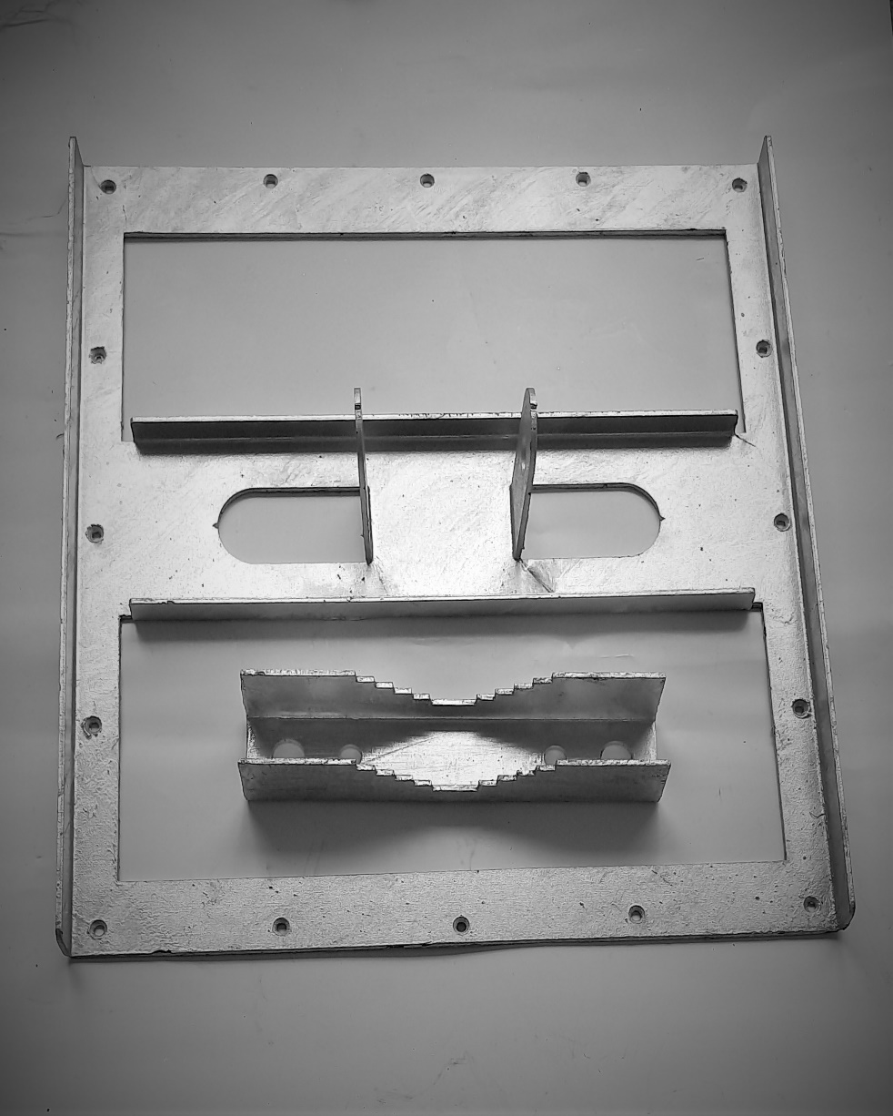
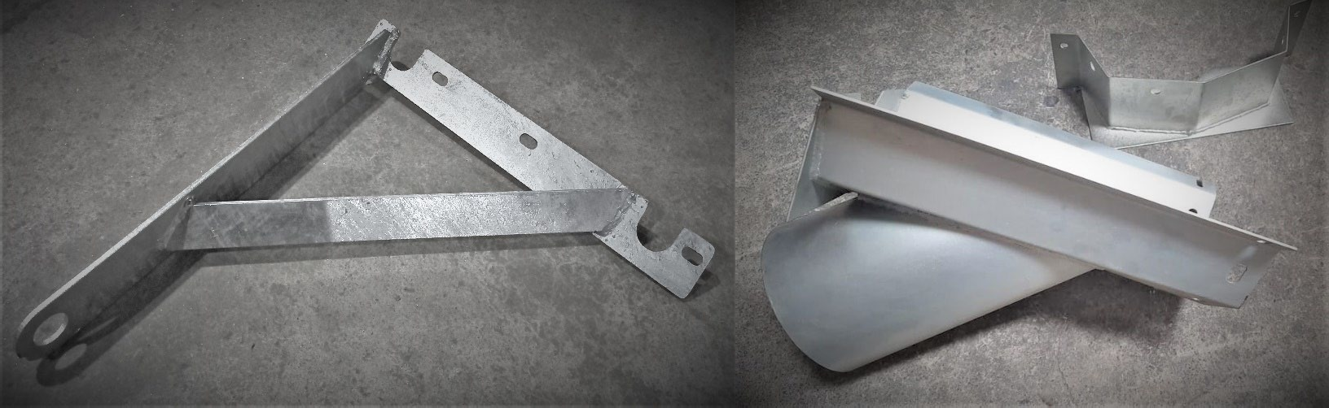
General Engineering components
10
Ajasra Vervetech
Ajasra Vervetech

Slide 11
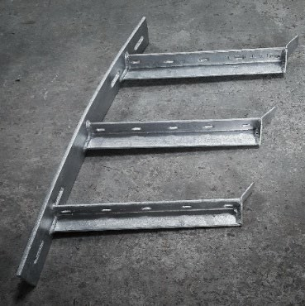
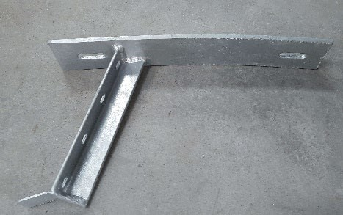

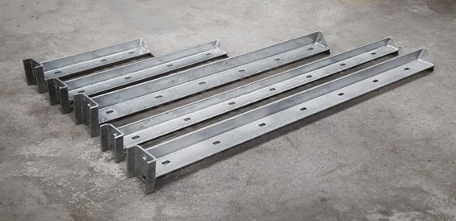
Metro components
11
Ajasra Vervetech
Ajasra Vervetech

Slide 12
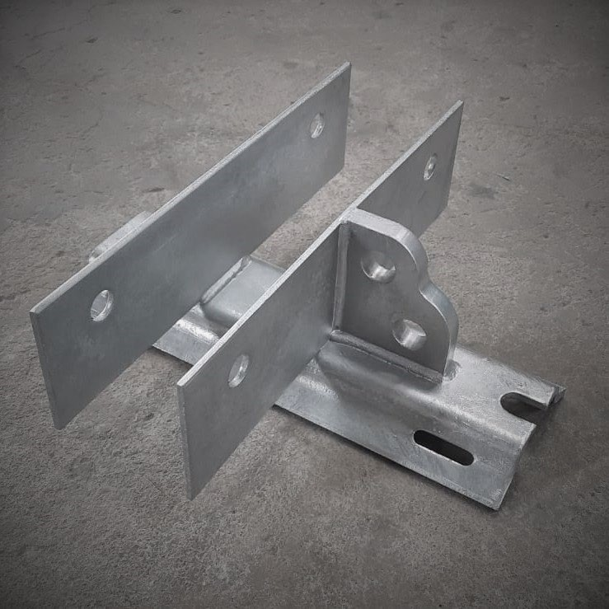
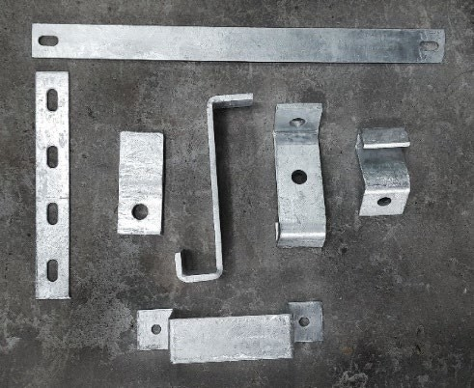

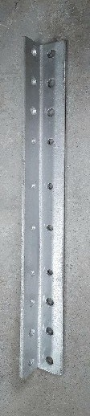
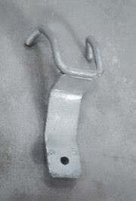
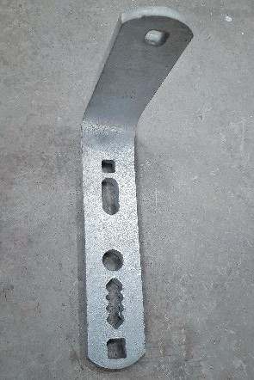
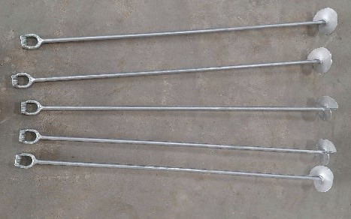
General Engineering components
12
Ajasra Vervetech
Ajasra Vervetech

Slide 13
Contact:
K.Sreedar – Executive Partner & CEO M/s. Ajasra Vervetech
Plot no. 274-D/B, Second Phase, Harohalli Industrial Area, Kanakapura Tq., Ramanagara Dist. Harohalli – 560 112
Mob- +91 82966 63245
Email- ajasravervetech@gmail.com Web: www.ajasravervetech.com
Ajasra Vervetech

Slide 14
Thank You
Ajasra Vervetech

